Slide 1
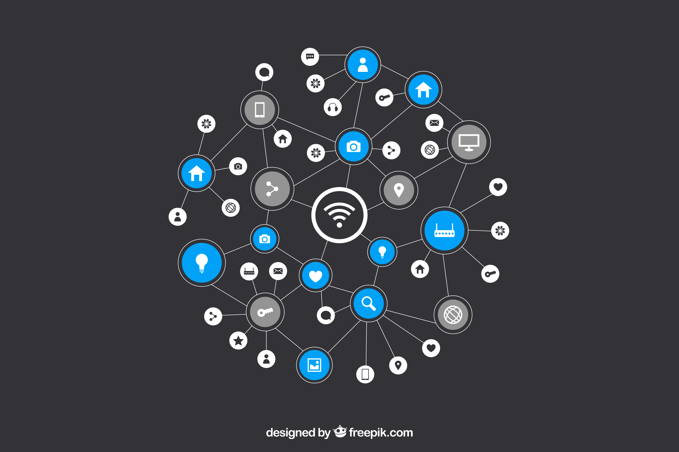
INTERNET OF THINGS
(IoT)
Introduction
BY: OTENG TANO KOJO

Slide 2
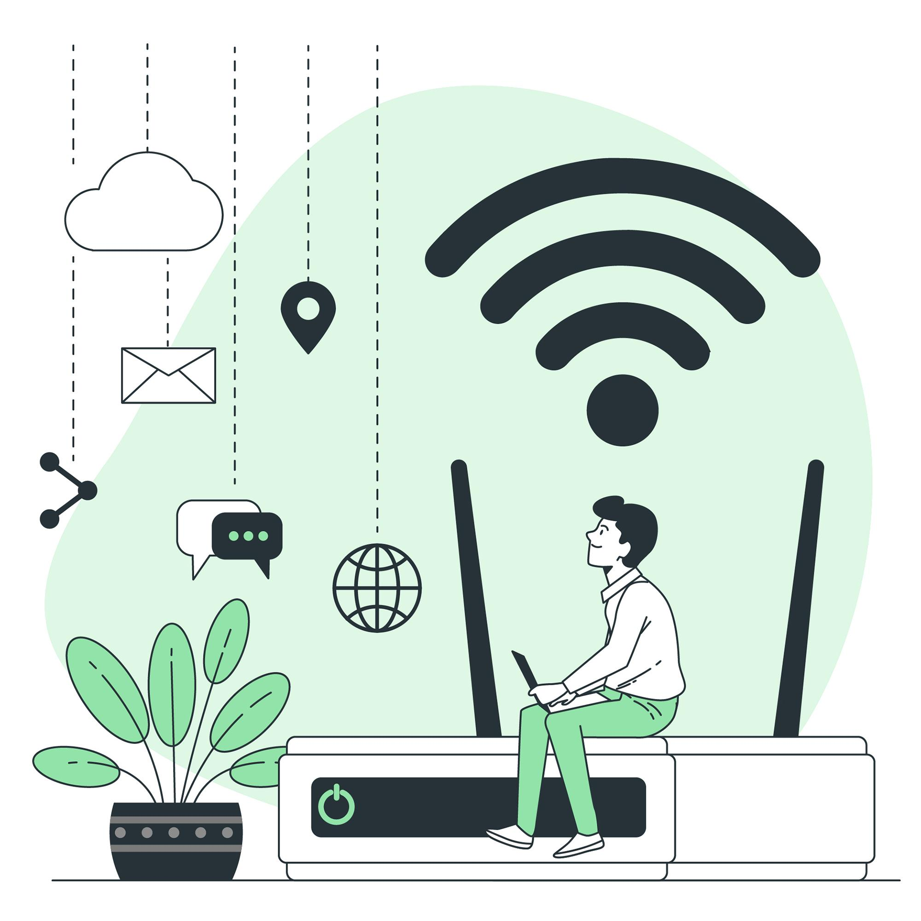
WHAT IS INTERNET OF THINGS?
The concept of IoT describes devices with sensors, processing ability, software and other technologies that connect and exchange data with other devices and systems over the Internet or other communications networks.

Slide 3
IoT Architecture And
Protocols
BY: OWUSU-ANSAH SOLOMON

Slide 4
UNDERSTANDING IoT Architecture
Blueprint for how IoT devices interact
Many different architectures available

Slide 5
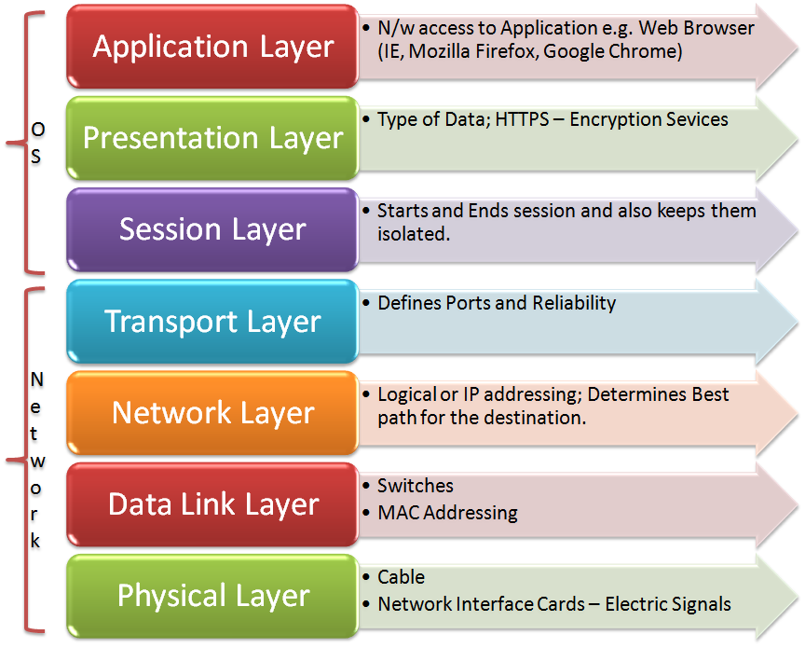
TYPES OF IoT Architectures
Open Systems Interconnection Model
Physical
Data-link
Network
Transport
Session
Presentation
Application

Slide 6
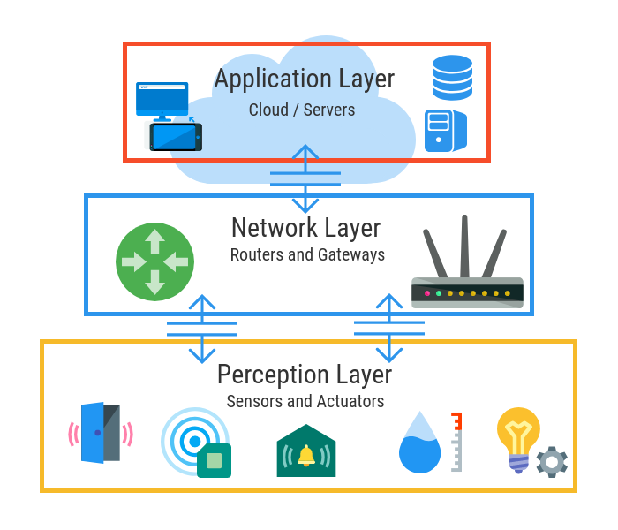
Three-layered Architecture
Perception or Physical layer
Sensors gather information here
Network layer
Connects,disconnects and translates devices
over a network
Application layer
Data is analysed,processed and used to generate
useful outcome here

Slide 7
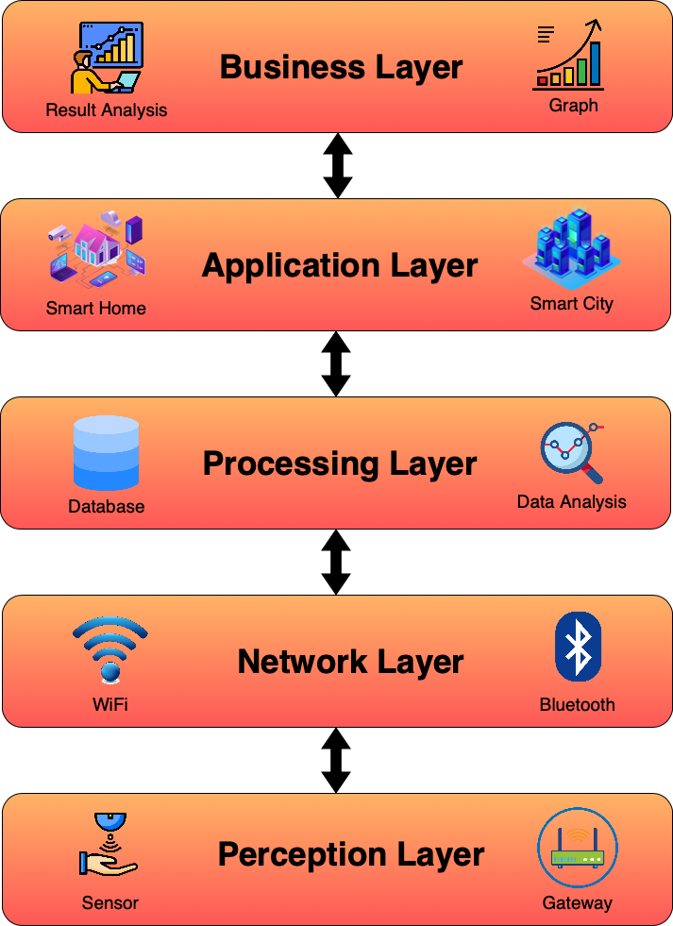
Five-layered Architecture
Business layer
Manages the entire IoT system,its functionality and business models
Application layer
Provides application-specific services to users
Processing layer
Analyses, stores and processes large data sets here
Network or Transport layer
Connects,disconnects and translates devices over a network
Perception or Physical layer
Sensors gathers information from the environment

Slide 8
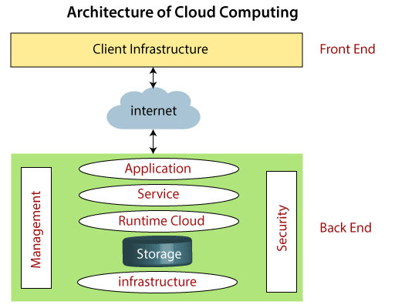
Cloud Computing Architecture
Has two main layers: Frontend and Backend
Frontend layer
Client infrastructure - It has the applications used by clients to access
the cloud computing service
Backend layer
Application - Software which the client accesses
Service - Manages the type of service the client accesses
Runtime Cloud - Provide runtime environment to the virtual
machines
Storage - For storing data in the cloud
Infrastructure - Provides serves and others needed to support the cloud computing model

Slide 9
Cloud Computing Architecture
Advantages of Cloud Computing Architecture
Scalability
Cost efficient
Flexibility and accessibility
Resource pooling
High availability
Automatic updates and maintenance

Slide 10
Fog Computing Architecture
Introduces a new layer between Physical and Transport layer called Fog layer
Processing takes place near the perception or physical layer
The fog layer is divided into four sub layers
The security layer - For encryption and decryption of data
The storage layer - For storing files and data
Pre-processing layer - For filtering, processing and analysing edge data
Monitoring layer - Monitors the power, resources and responses

Slide 11
Fog Computing Architecture
Advantages of Fog Computing Architecture
Faster reactions
Less Traffic Jam
Reduced Latency
Increased reliability
Improved bandwidth efficiency
Enhanced security

Slide 12
Edge Computing Architecture
Closely related to the fog architecture
Keeps processing capabilities and functionalities closer to the edge nodes.
Processing takes place at the physical or perception layer directly on an IoT device
Useful for applications that require real-time performance
Can work independently or in combination with fog or cloud computing architecture

Slide 13
Edge Computing Architecture
Advantages of Edge Computing Architecture
Reduced latency than fog architecture
Saves times and money by streamlining IoT communication
Reduces system and network architecture complexity
Allows for decentralisation of computing
Increased data privacy

Slide 14
Software Defined Network (SDN) Architecture
Introduces a Control layer between the Network and Application Layer
Perception Layer: This layer remains the same as traditional architectures, containing sensor-equipped devices and actuators.
Network Layer: This layer gets a revamp with SDN. It includes SDN gateways and routers that forward data based on instructions from the SDN controller. These gateways can be intelligent, making decisions based on network conditions.
Control Layer: This layer introduces the SDN controller, the brain of the network. It receives information from the devices and applications, analyzes it, and then programs the SDN gateways on how to handle data flow.
Application Layer: This layer includes the applications that interact with the data collected from the devices. SDN allows for more dynamic control over how application needs are met by the network.

Slide 15
Software-Defined Network (SDN) Architecture
Advantages of Software-Defined Network (SDN) Architecture
Intelligent traffic management
Scalability and Flexibility
Simplified overall management
Enhanced security

Slide 16
Some other IoT Architectures
Mist Computing Architecture
Quality of Service Based Architecture
Service Oriented Architecture
Mobility First Architecture
Cloud Things Architecture
IoT-A Architecture
S-IoT Architecture

Slide 17
UNDERSTANDING IoT Protocols
IoT protocol is a set of rules IoT entities must have in common in order to communicate
It governs what their interactions look like, what values can be transmitted, and how they are received and processed and the security methods associated

Slide 18
IoT Protocols are grouped under the following
IoT Application Protocols
IoT Protocols for Consumer Devices
IoT Transport Protocols
IoT Network Protocols
IoT Physical Layer Protocols
IoT Data-Link Layer Protocols
IoT Security Protocols

Slide 19
IoT Application Protocols
Message Queueing Telemetry Transport (MQTT)
Communication protocol specially designed for IoT and M2M applications
Ideal for remote environments or places with limited bandwidth
Uses connection-oriented publish/subscribe architecture where applications can either publish (transmit) or subscribe (receive) topics
Uses MQTT broker to pass information from publishing client to the subscribed client

Slide 20
IoT Application Protocols
Advanced Message Queueing Protocol (AMQP)
Open source protocol for Message-Oriented Middleware (MOM)
Designed to facilitate communication between systems and devices from multiple vendors
In contrast to MQTT, it supports more routing options than just publish/subscribe on topics. Hence, more flexible than MQTT
This flexibility results in more complexity on application setup and additional protocol overhead
Supported by Azure IoT for device communication

Slide 21
IoT Application Protocols
Data Distribution Service (DDS)
Real-time interoperable communication protocol
Designed for systems that require significant cordination, reliable transmissions and distributed processing between devices
Instead of sending data to a central hub or broker, data can be directly been exchanged between peers making it more robust and efficient
Uses a publish/subscribe mechanism where devices subscribe to a topic and devices sending to the topic are then using multicast to distribute the information to the subscribers

Slide 22
IoT Protocols For Consumer Devices
Z-Wave
Smart home protocol that uses a mesh network topology to connect devices to a central hub
Offers longer range than early generations of Bluetooth and uses less power than WiFi
When a consumer issues a command to a connected device through a smartphone or PC, the data packet uses the mesh of connected devices as nodes to reach the central hub, which then routes the data through the nearby devices to reach its intended destination

Slide 23
IoT Transport Protocols
User Datagram Protocol (UDP)
Prioritises speed over reliability
Uses a connectionless process to send data packets to a destination
Provides low latency
Ideal for time-sensitive use cases like video streaming, Voice over Internet Protocol (VoIP), video gaming, and Domain Name System (DNS) lookups

Slide 24
IoT Transport Protocols
Transmission Control Protocol (TCP)
Prioritises accuracy and reliability over speed
Sets the parameters for data exchanges between software applications
Confirms what is being sent, where it’s coming from, where it’s going, and whether or not it arrived correctly
Reduces errors and duplication as a result of its accuracy

Slide 25
IoT Network Protocols
Internet Protocol (IP)
Basically the key to the internet
Give network entities address
The addresses allows other network entities to send them data packets even if they are not on the same network
IPv4 and IPv6

Slide 26
IoT Data-Link and Physical Protocols
Near Field Communication (NFC)
Builds on Radio Frequency Identification
Facilitates connectivity between devices within 1.5 inches of each other
Used to access online services through the connection
Used in modern applications like tap-to-pay

Slide 27
IoT Data-Link and Physical Protocols
Long Term Evolution (LTE)
4G standard protocol
Built on 2G and 3G cellular infrastructure
Provides faster internet connection speeds and excellent coverage
Not suitable for battery-powered IoT devices and expensive

Slide 28
IoT Security Protocols
Internet Protocol Security (IPSec)
Protects network communications at the IP layer
Facilitates two-way authentication between involved network entities
Uses keys to authorise data packets

Slide 29
IoT Security Protocols
Open Virtual Private Network (OpenVPN)
Uses point-to-point or site-to-site models to create VPNs
Uses 256 bit encryption
Enables a client and server to authenticate each other with a pre-shared key and certificate
Essential for remotely maintaining and analysing IoT devices

Slide 30
Other IoT Protocols
WiFi
Bluetooth
LTE-M
Power Line Communication
Transport Layer Security
SigFox
5G
GPRS
GSM and many more...

Slide 31
Sensor networks in IoT

Slide 32
Sensor networks
Sensor: an electronic device that is capable of perceiving and recording data from the environment. E.g. Temperature sensor, Water sensor, Vibration sensor.
A network refers to the linking of two or more components to share resources. E.g. LAN, WAN, etc.
A sensor network refers to how spatially dispersed sensors transfer their data to a centralized device for further processing into information

Slide 33

Types of sensor networks
Wired sensor networks: This type of sensor network deals with interconnecting various nodes to share data with the centralized device via physical wires. E.g., wire jumpers, copper wires, etc. This type of network is less common than wireless sensor networks because it can be more difficult and expensive to deploy.
Wireless Sensor Networks: This deals with sharing information with the centralized device without the use of physical wires. This type of network is more common because it is easier and less expensive to deploy. Also, wireless sensor networks are more flexible and can be used in a wider variety of applications.

Slide 34

Components of a sensor network
A sensor network comprises Sensors, a Gateway, a Network, and a data center.
Sensor: collect data from the environment
Gateway: Collects data from sensors and transmits it further
Network: Enables communication between sensors and gateway. Through various protocols such as Bluetooth, ZigBee etc
Data Center(Cloud): Stores, processes, and analyzes collected data

Slide 35
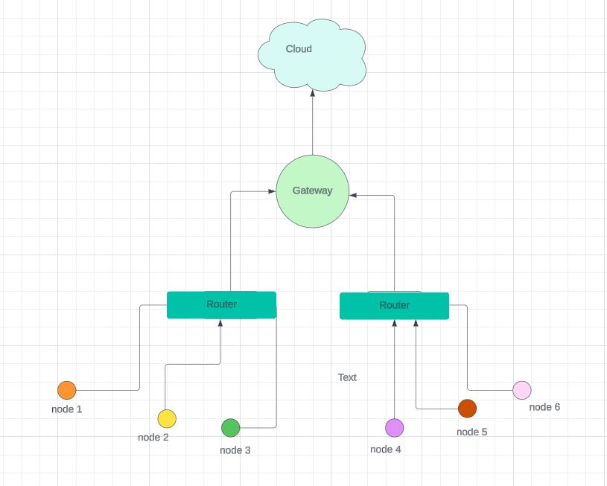
Organization of a wireless sensor networks

Slide 36
Why the multi-step journey
Scalability and efficiency
Data Aggregation and Filtering
Security
Connectivity and Processing Power

Slide 37
Applications of sensor networks
Environmental monitoring: Air and water quality, weather forecasting
Precision agriculture: Optimize crop yields, water usage
Structural health monitoring: Bridges, buildings, pipelines
Industrial automation: Monitor machinery, optimize production processes
Smart cities: Traffic management, waste collection, energy efficiency

Slide 38
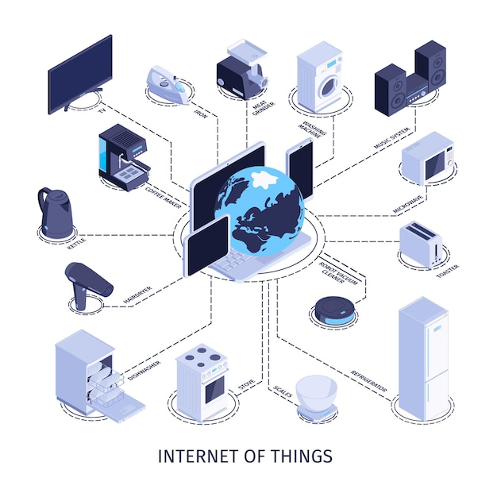
DATA COLLECTION IN IoT
What is Data Collection in IoT?
BY: OTENG TANO KOJO

Slide 39
What is Data Collection in IoT?

Slide 40
What is Data Collection in IoT?
Data collection in IoT refers to the process of gathering information from various sources such as sensors, devices, and systems connected to the IoT ecosystem.

Slide 41
Various Types of IoT Data You Can Collect
Automation data. It comprises insights into the automated systems’ performance, status, and operation.
Equipment data. It provides insights into the usage, wear and tear, and performance of sensors, machines, or vehicles.
Environmental data. It includes information on the physical environment, such as temperature, humidity, movement, air quality, noise levels, etc.
Submeter data. Submetering includes information on energy consumption, such as electricity, gas, or water.
Location data. It comprises information on the location and movement of people, objects, or vehicles.

Slide 42
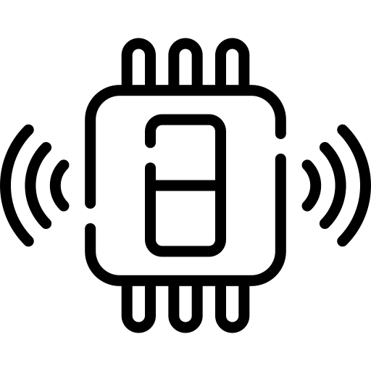

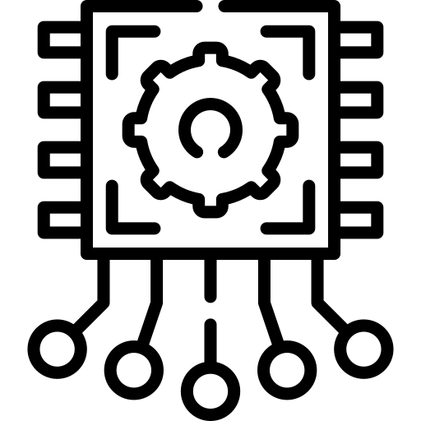
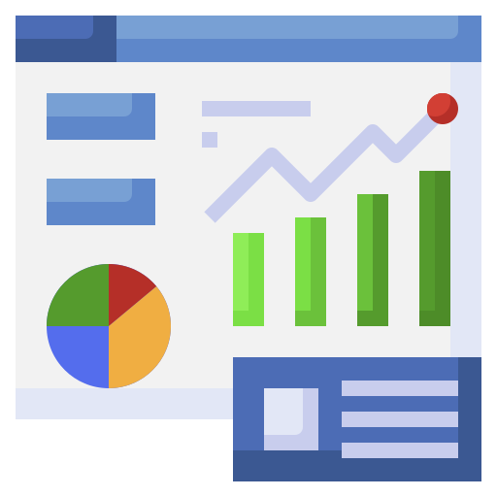
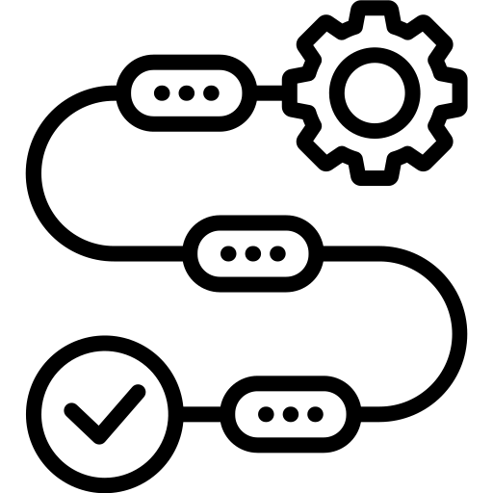
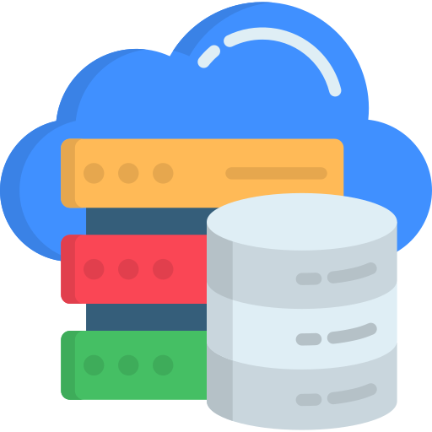
How Does IoT Data Collection Work?

Slide 43
How Does IoT Data Collection Work?
IoT Data Collection Categories
Principles for IoT Data Collection
1
2
Scalability
Security
Interoperability
Flexibility
Firmware Level
Server Side
Level

Slide 44
Firmware Level
1
2
Data Storage on a Local or Cloud Server:
In this approach, IoT devices are designed to transmit data to a server as soon as it's collected. This real-time transmission requires a stable internet connection and low latency to ensure timely delivery of data. The advantages of this method include:
Real-Time Insights
Scalability
Accessibility
However, there are challenges associated with this approach:
Dependency on Connectivity
Security Concerns
Costs
Server Side
Level

Slide 45
Firmware Level
1
2
Data Storage on the IoT Device’s Internal Memory:
Alternatively, IoT devices can store collected data locally in their internal memory or storage. This offline data storage approach enables devices to operate autonomously and store data even when there's no immediate connection to a server. The benefits of this method include:
Resilience to Connectivity Issues.
Reduced Dependency on Real-Time Transmission.
Lower Bandwidth Usage
However, there are challenges to consider:
Limited Storage Capacity
Data Latency
Data Integrity
Server Side
Level

Slide 46
2
Server Side Level
Firmware Level
1
1. API Support for Data Reception:
- To begin with, the server infrastructure needs to be equipped with an Application Programming Interface (API) that can receive data from all connected IoT devices. This API acts as the interface through which devices can transmit their data to the server.
2. Data Storage:
- Once the server receives data from IoT devices through the API, it needs to be stored in a persistent and scalable storage system. This could be a database management system (DBMS) or a distributed storage
3. Scalability and Performance:
- Considering that the data volume from IoT devices can be substantial, the server infrastructure must be designed to handle this load efficiently.
4. Data Processing and Analysis:
- Besides storing the incoming data, the server may also need to perform further processing and analysis to derive meaningful insights or trigger actions based on the received data
Data Storage on the IoT Device’s Internal Memory:
Alternatively, IoT devices can store collected data locally in their internal memory or storage. This offline data storage approach enables devices to operate autonomously and store data even when there's no immediate connection to a server. The benefits of this method include:
Resilience to Connectivity Issues.
Reduced Dependency on Real-Time Transmission.
Lower Bandwidth Usage
However, there are challenges to consider:
Limited Storage Capacity
Data Latency
Data Integrity

Slide 47
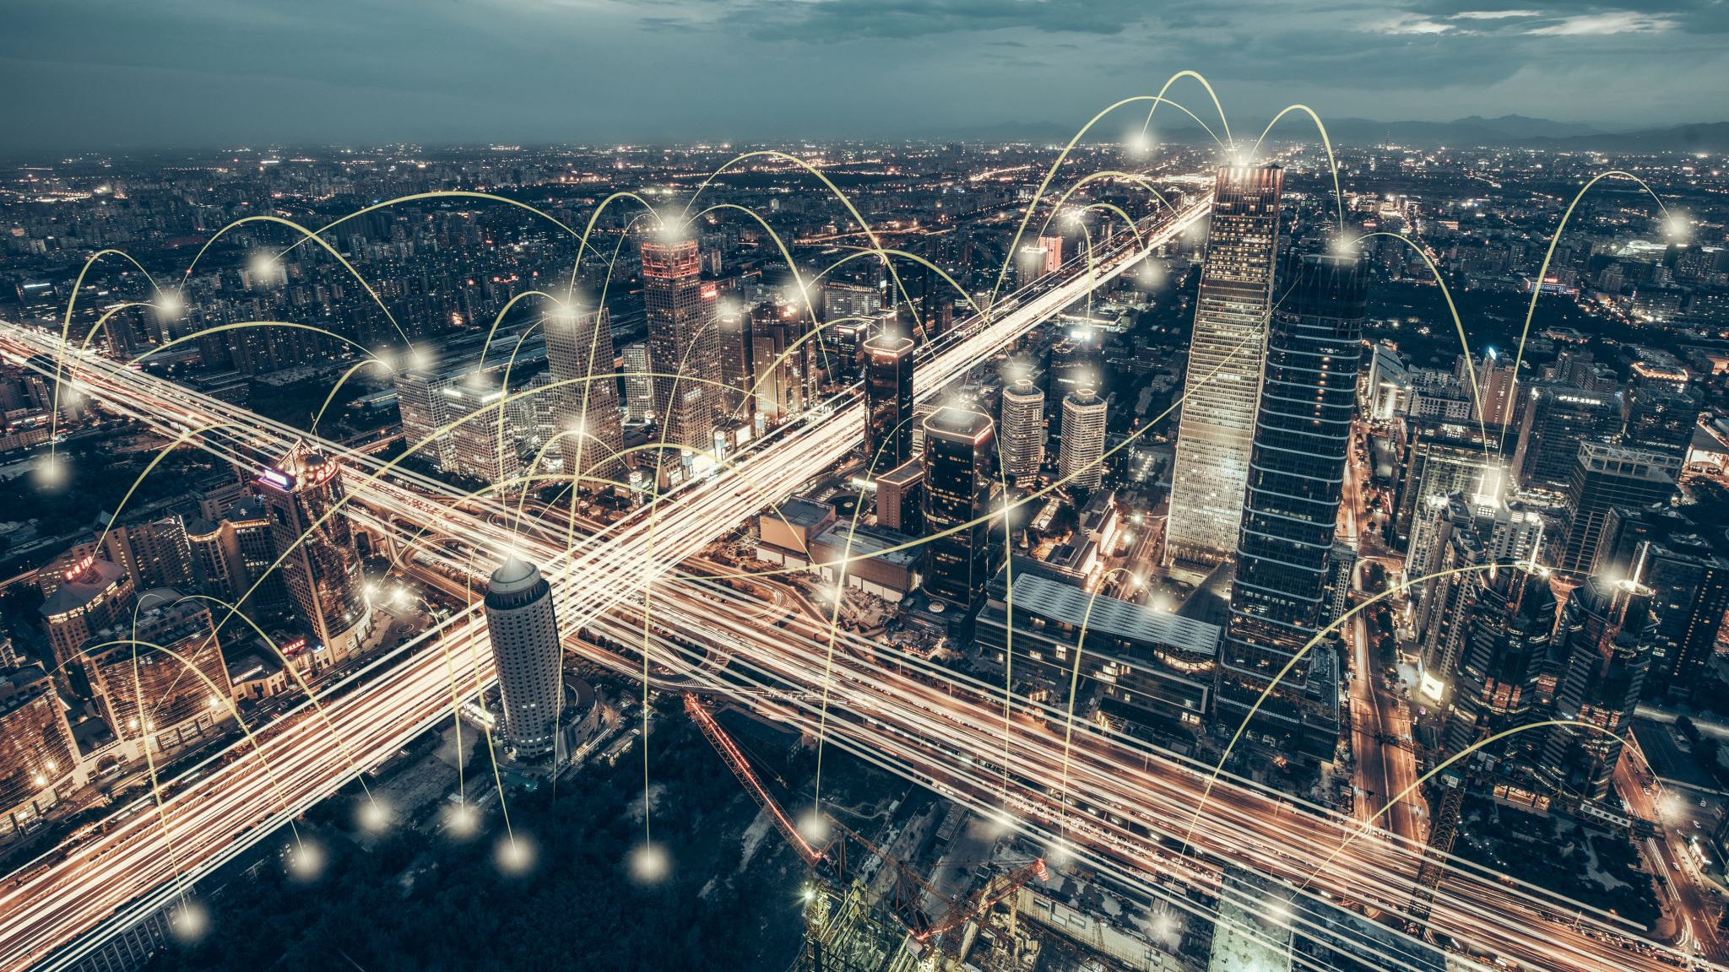
EDGE COMPUTING IN IoT

Slide 48
INTRODUCTION
Edge computing represents a rising paradigm in computing that involves a variety of networks and devices located near or at the user's end. The core idea behind edge computing is to process data in close proximity to its source, allowing for faster and more substantial data processing. This approach leads to more immediate and impactful results in real-time situations.

Slide 49
KEY CONCEPTS
EDGE DEVICES: Physical entities in the Internet of Things (IoT) ecosystem that generate, collect, or transmit data. These devices are equipped with computational capabilities and sensors, and they play a crucial role in the distribution of processing tasks closer to the data source.
EDGE COMPUTING: Brings fast decision-making directly to devices, minimizing data travel, enhancing privacy, and ensuring reliability, thereby making everyday technologies smarter and more responsive.
EDGE NODES AND FOG COMPUTING: Edge nodes act as intermediaries between devices and the cloud in edge computing, providing additional processing power and storage; meanwhile, fog computing extends this by adding intelligence to the network, enabling more complex computations closer to the edge for increased efficiency. Together, edge nodes and fog computing contribute to a decentralized computing approach, enhancing the performance and capabilities of Internet of Things (IoT) ecosystems.

Slide 50
DIFFERENCES B/N IoT DEVICES AND EDGE COMPUTING DEVICES
IOT DEVICES
EDGE COMPUTING DEVICES
Focus is on data generation and collection.
Processes data remotely in a centralized cloud.
Transmits data to a centralized location
Focus is on local data processing and decision-making
Processes data locally at or near the source
They have built-in connectivity but focus on local processing

Slide 51
HOW IOT AND EDGE ARE RELATED
FAULT TOLERANCE: In IoT, network disruptions or server outages can impact the functionality of IoT applications and in Edge Computing, devices can continue to operate locally, even in the absence of a stable network connection, ensuring that critical functions can still be performed.
REAL-TIME DECISION-MAKING: In IoT, some applications like autonomous vehicles or industrial automation, require instantaneous decision-making based on real-time data and in Edge Computing, processing data locally enables quick decision-making without the delay of sending data to and from centralized cloud servers.

Slide 52
ADVANTAGES
REDUCED LATENCY
BANDWIDTH EFFICIENCY
IMPROVED PRIVACY AND SECURITY
RELIABILITY
SCALABILITY
REAL-TIME DECISION MAKING
ENERGY EFFICIENCY
COST EFFICIENCY
OPRATIONAL AUTONOMY
ENHANCED USER EXPERIENCE

Slide 53
CHALLENGES
RESOURCE CONSTRAINTS
STANDARDIZATION ISSUES
DATA MANAGEMENT COMPLEXITY
SECURITY CONCERNS
INTERMITTENT CONNECTIVITY
SCALABILITY CHALLENGES
INTEGRATION WITH EXISTING SYSTEMS
LIMITED DEBUGGING AND MONITORING TOOLS
EDGE AI COMPLEXITY

Slide 54
USE CASES
INDUSTRIAL IOT: Predictive maintenance, monitoring, and control.
SMART CITIES: Traffic management, waste management, and environmental monitoring
HEALTHCARE: Remote patient monitoring, medical device integration
RETAIL: Inventory management, personalized customer experiences.
SMART GRIDS: Monitoring and control of energy distribution
AUTONOMOUS VEHICLES: Quick decision-making for navigation, obstacle detection, and collision avoidance

Slide 55
TECHNOLOGIES
EDGE PLATFORMS: Platforms for application development and deployment.
MACHINE LEARNING: Implementing ML models on edge devices
EDGE GATEWAYS: Devices connecting edge devices to the cloud.
EDGE ANALYTICS: Local data analysis for deriving insights
COMMUNICATION PROTOCOLS: Lightweight protocols like Message Queuing Telemetry Transport (MQTT) and Constrained Application Protocol (CoAP)

Slide 56
Emerging trends and future considerations
5G INTEGRATION: The rollout of 5G networks enhances the capabilities of edge computing by providing faster and more reliable connectivity.
EDGE AI: Integration of artificial intelligence at the edge.
EDGE-as-a-SERVICE (EaaS): Emergence of platforms providing edge computing resources.
HYBRID ARCHITECTURES: Combining edge computing with cloud services.
DISTRIBUTED CLOUD COMPUTING: Exploration of distributed cloud computing models, bringing cloud capabilities closer to the edge.

Slide 57
CONCLUSION
In our look into edge computing in the Internet of Things, we've checked out the basic ideas, the tech stuff, and how things are changing. Edge computing is like a key solution fixing issues we have with the usual way we set up IoT systems.
KEY INSIGHTS
Edge computing optimizes data processing, reducing latency and enhancing system efficiency. Challenges, such as resource constraints and security concerns, are being met with emerging technologies and standardization efforts. Businesses benefit from reduced latency, improved security, and enhanced scalability.

Slide 58
CONCLUSION CONT’D
In navigating the edge of IoT, we embrace a future where every data point matters, and every decision is made at the speed of now. Edge computing is not just a technology; it's a transformative force shaping the next era of IoT possibilities. The edge is not just where data meets processing; it's where possibilities meet reality.

Slide 59
REAL-TIME ANALYTICS IN INTERNETOF THINGS ( IoT)

Slide 60
Introduction
Real-time analytics plays a crucial role in distributed computing by enabling us to gather insights from IoT data as it's generated, allowing for quick and informed decision-making.

Slide 61
Technologies and Tools
Real-time analytics in IoT relies on different technologies and tools.
Stream processing frameworks like Apache Kafka and Apache Flink handle large amounts of streaming data instantly.
Data visualization tools like Tableau and Power BI help us understand and visualize the data we analyze.
Also, machine learning algorithms predict future outcomes, providing valuable insights for making proactive decisions.

Slide 62
DEFINITION AND PURPOSE
Real-time analytics in IoT means gathering, processing, and studying data from IoT devices instantly.
Its goal is to get useful insights from this data right away.
This helps businesses and organizations react quickly to changes, spot trends, and make smart decisions to improve how they work and come up with new ideas.

Slide 63
Use Cases
Real-time analytics in IoT has numerous real-world applications.
In smart cities, it facilitates traffic management, energy optimization, and environmental monitoring.
In industrial IoT, it enables predictive maintenance, optimizing production processes, and ensuring operational safety.
In healthcare, it aids in remote patient monitoring and early disease detection.
In manufacturing, it helps in detecting anomalies and optimizing supply chain operations.

Slide 64
Challenges and Solutions
Despite its benefits, real-time analytics in IoT comes with challenges such as;
Handling large volumes of data.
Ensuring low latency.
Maintaining scalability.
Solutions include using;
Distributed computing architectures.
Implementing data preprocessing techniques.
Leveraging edge computing to reduce latency and bandwidth usage.

Slide 65

ENERGY EFFICIENCY IN DISTRIBUTED INTERNET OF THINGS (IoT) SYSTEMS.
David Awitor.

Slide 66
ENERGY EFFICIENCY
Energy efficiency is a concept that goes beyond simply using less energy. It's a philosophy and a set of practices aimed at getting the most usable output from the least amount of energy input.
In other words, energy efficiency focusses on getting the most out of the energy you use with the aim of reducing the amount of energy required to perform a specific task or achieve a desired outcome.
Talking about energy efficiency brings into mind ways we manage this energy in distributed IoT systems and that is when energy management comes into play.
Energy management is the process of monitoring, controlling, and conserving energy usage in distributed internet of things systems.

Slide 67
DISTRIBUTED IoT
Distributed IoT, also known as Fog Computing IoT or Edge Computing IoT, is a paradigm shift in the way we connect and manage devices within the Internet of Things (IoT).
Within the years of 1990 - Mid-2010, Traditional Centralized IoT dominated the world making all devices to collect and send data to a centralized cloud server regarded as a giant brain for processing and analysis.
This approach works well for small deployments, but struggles with scalability and latency as the number of devices grow and hence the need for a distributed approach to IoT. It is predicted that the quantity of Internet of Things (IoT) gadgets across the globe will increase nearly threefold, rising from 9.7 billion in 2020 to over 29 billion in 2030.
Distributed IoT therefore Empowers devices and edge computing nodes to process and analyze data locally, before potentially sending it to the cloud. Think of it as distributing intelligence throughout the network, closer to the data source. Devices become mini-brains, making real-time decisions without relying solely on the cloud.

Slide 68
Benefits of Distributed IoT:
Efficiency: Reduces energy consumption by processing data locally instead of constantly transmitting it to the cloud.
Scalability: The network can accommodate a significant increase in connected devices without performance issues.
Real-time Decisions: Enables faster response times for applications requiring immediate action (e.g., industrial automation).
Security: Sensitive data can be processed locally, potentially reducing security risks associated with cloud storage.

Slide 69
Challenges of Energy Consumption
Distributed IoT systems, while offering widespread connectivity and data collection capabilities, face unique challenges regarding energy efficiency due to the large number of resource-constrained devices often powered by batteries.
Limited battery life of resource-constrained devices
Frequent data transmission leading to high energy consumption.
Environmental impact of e-waste generated by battery replacements.

Slide 70
Techniques for Energy Efficiency
Device-Level Optimization: Optimizing individual devices for low power consumption is crucial. This involves:
Hardware selection: Choosing low-power microcontrollers with efficient processing capabilities and sleep modes.
Software optimization: Developing application logic that minimizes unnecessary processing, utilizes low-power communication protocols (e.g., Bluetooth Low Energy), and leverages hardware features like sleep timers and power gating (disabling unused hardware components).
Data aggregation and filtering: Pre-processing and filtering data on the device itself before transmission can significantly reduce the amount of data sent, minimizing energy consumption for communication.

Slide 71
Techniques for Energy Efficiency
Communication Optimization: Efficient communication protocols and network design are essential. This includes:
Short-range communication: Utilizing technologies like Bluetooth Low Energy or Zigbee for short-range communication with lower power requirements compared to Wi-Fi.
Duty cycling: Devices can periodically switch between active and sleep states, minimizing communication overhead and extending battery life.
Clustering and aggregation: Grouping devices and aggregating data before sending it to the network can reduce the number of transmissions and the associated energy consumption.

Slide 72
Techniques for Energy Efficiency
Computational Offloading: Offloading computation-intensive tasks from resource-constrained devices to more powerful edge devices or the cloud can reduce energy consumption on individual nodes. This involves:
Task partitioning: Dividing tasks between devices based on their capabilities, with simpler tasks handled by the IoT devices and complex tasks offloaded to edge or cloud resources.
Federated learning: Training machine learning models collaboratively across multiple devices without sharing all the data, reducing local processing requirements and communication overhead

Slide 73
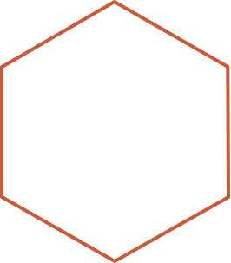
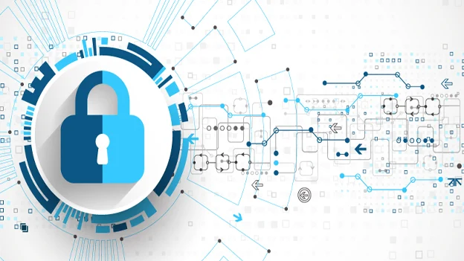

Security and Privacy Challenges in IoT
Owusu-Ansah Yaw

Slide 74


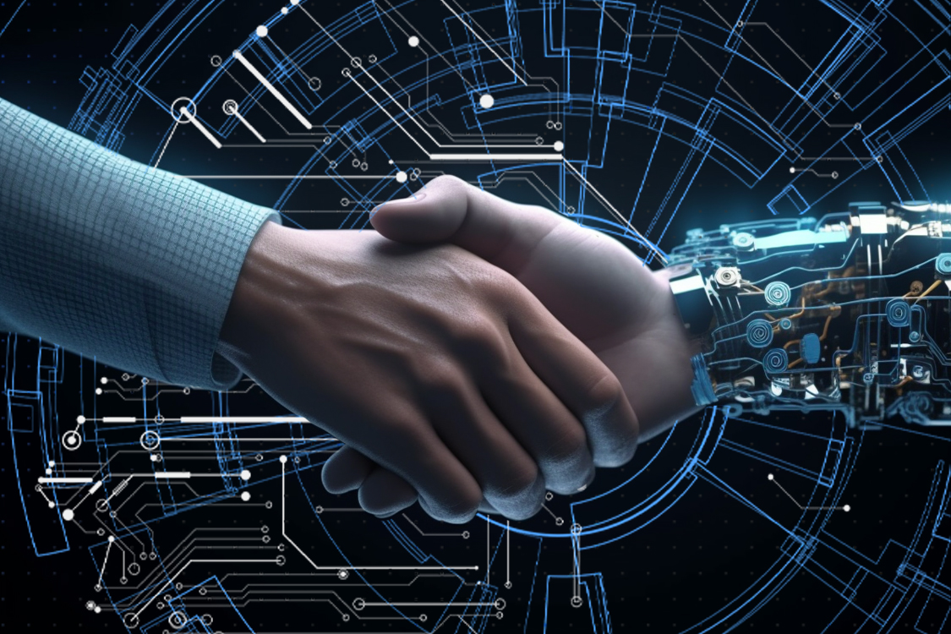
Security Goals Security and Privacy refers to the protection of any collected or stored data in any IoT system.
Trust relations between each IoT Layer
Proper communication and transition between the different layers of an IoT system and between the different existing nodes is needed to ensure security and privacy of data.
Trust for the security and privacy at each IoT layer
Security and privacy goals at each layer in IoT system needs to be preserved under any circumstances providing reliability, integrity and confidentiality of data
Trust between the user and the IoT system
There is a need to provide a level of trust between the IoT system and the end user for the successful employment of the IoT concept.

Slide 75
Classification of Security Attacks
Physical Attacks
Network Attacks
Software Attacks
Encryption Attacks
Node Tampering
RF Interference
Node Jamming
Physical Damage
Social Engineering
Sleep Deprivation Attack
Malicious Node Injection
Traffic Analysis Attacks
RFID Spoofing
RFID cloning
Sinkhole Attack
Man In The Middle Attack
Denial of Service
Routing Information Attacks
Virus and Worms
Spyware and Adware
Trojan Horse
Malicious scripts
Denial of Service
Side Chanel Attacks
Cryptanalysis Attacks
Man In the Middle Attack
75

Slide 76
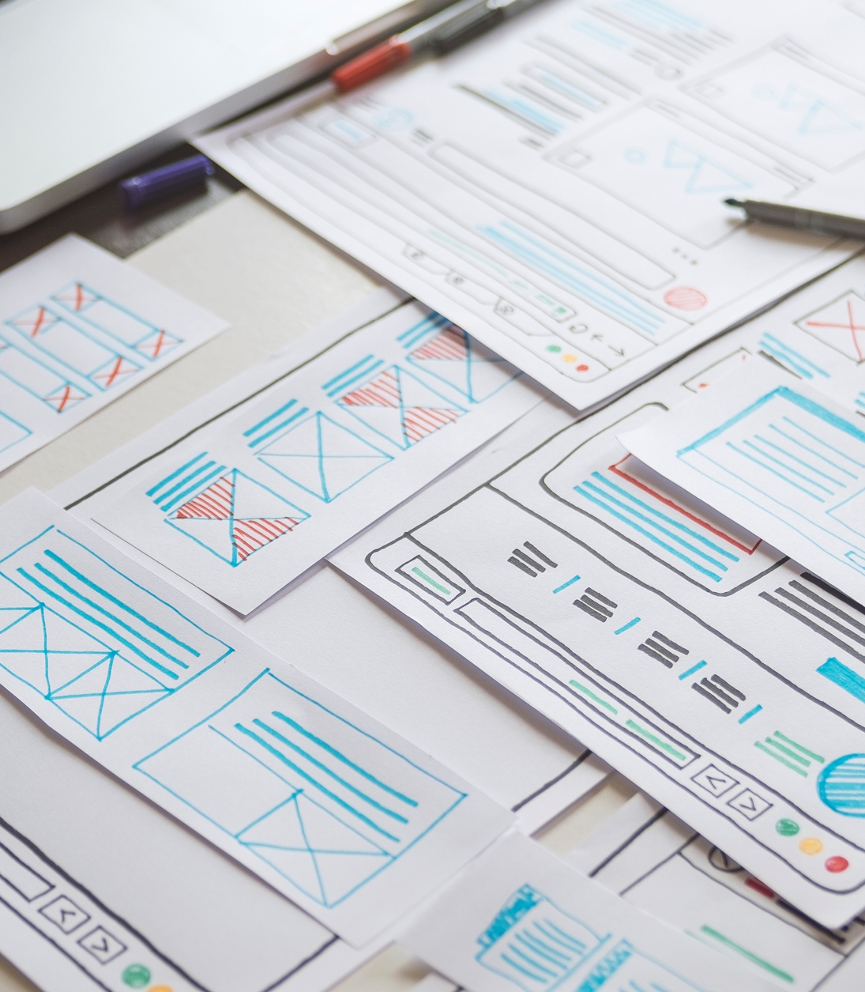

Security Future Directions
SECURITY FUTURE DIRECTIOONS

Slide 77





IoT Physical Layer Security
Secure Booting
Device Authentication
Data Integrity
Data Confidentiality
Anonymity
Authentication of software on device using cryptographic hash
New devices must be authenticated before receiving or transmitting data
Ensure no tampering of sensitive data occurs
All RFID tags, IDs and data should be encrypted on each device before transmission of data
Sensitive information like location and identity of some nodes should be hidden

Slide 78
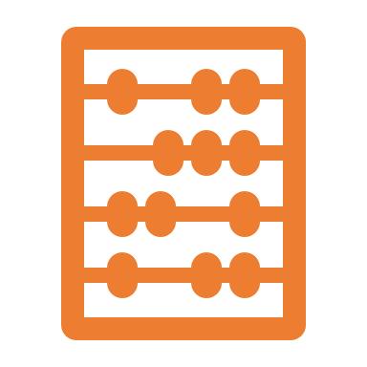


IoT Network Layer Security
Data privacy
Illegal access to the sensor nodes can be prevented, using authentication mechanisms and point to point encryption.
Routing security
Secure routing can be ensured by providing multiple paths for the data routing which improves the ability of the system to detect an error
Data integrity
The integrity of the data received on the other end is confirmed using cryptographic hash functions.
78

Slide 79
IoT Application Layer Security
Data security
Using authentication encryption and integrity mechanisms
Access Control Lists(ACLs)
Setting up policies and permissions of allowed devices
Firewalls
Anti-virus
Using an extra effective layer of security to block attacks
Antivirus or anti-spyware is important for the security and privacy of the IoT system
79

Slide 80
“To insure the continued protection of an IoT system and maintain its trustworthiness, Risk Assessment, Intrusion Detection, Physical Security and Trust Management should be mandatory at all layers in IoT.”
Ioannis Andrea, Chrysostomos Chrysostomou, George Hadjichristofi
80

Slide 81
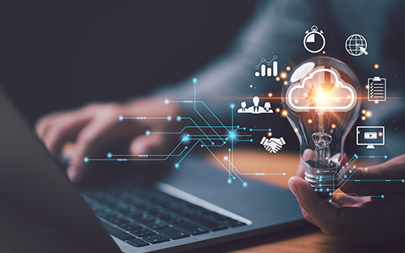
IoT APPLICATION
AND
CASE STUDIES

Slide 82

WHAT IS A CASE STUDY IN RELATION TO IoT ?
Refers to a detailed analysis of how IoT technology is applied in a real-world scenario to address specific challenges or achieve a particular objective.

Slide 83

STEPS IN IOT CASE STUDY
USING SMART CROP MONITORING

Slide 84
STEP 1
STEP 2
Problem Statement:
An overview of the issue or opportunity that prompted the implementation of IoT technology.
Solution description:
Details about the IoT deployed, including hardware (sensors, actuators, devices), software (data analytics, algorithms, dashboards), and connectivity (protocols, networks).

Slide 85
STEP 3
STEP 4
Implementation Process:
Steps taken to deploy the IoT solution, including installation, configuration, integration with existing systems and texting.
Results and Benefits:
Measurable outcomes and benefits achieved through the implementation of IoT, such as increased efficiency, cost savings, improved decision-making, or enhanced user experiences.

Slide 86

STEP 5
Challenges and Lessons learned:
Any obstacle encountered during implementation, along with insights gained and recommendations for future deployments.

Slide 87
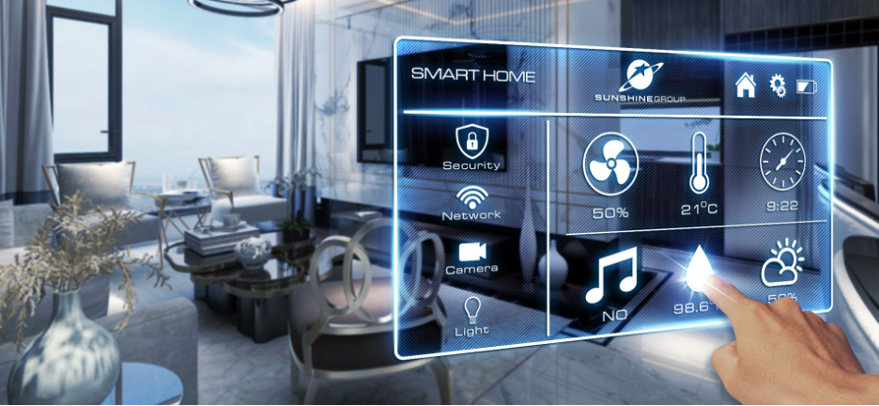
IoT APPLICATIONS
IoT applications span various industries and sectors, revolutionizing how devices connect, communicate, and collect data. Here are some popular IoT application areas.

Slide 88
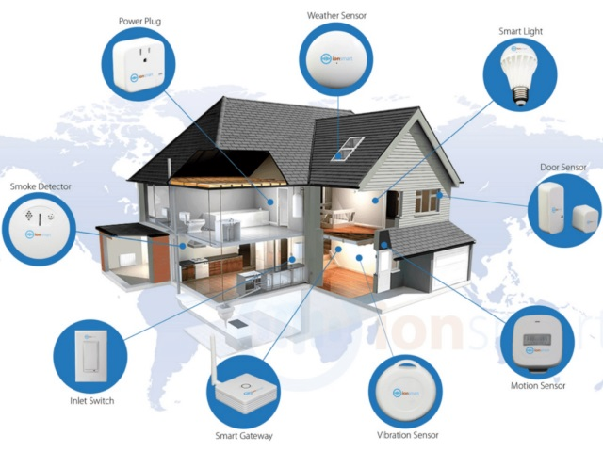
SMART HOME
Smart Lighting:
Allows users to control lighting remotely via smartphones, enhancing convenience and energy efficiency.
Smart Appliances: IoT-enabled appliances, such as refrigerators, ovens, washing machines, and dishwashers, offer advanced features such as remote monitoring, scheduling, and diagnostics. Users can receive notifications when appliances require maintenance or when a laundry cycle is complete.

Slide 89


HEALTH CARE
Wearable Health Trackers:
Fitbit and Apple Watch track users’ physical activity, heart rate and sleep patterns, empowering individuals to monitor and improve their health.
Remote Patient Monitoring:
With devices like continuous glucose monitors, healthcare providers can remotely monitor patients’ health parameters in real-time.

Slide 90
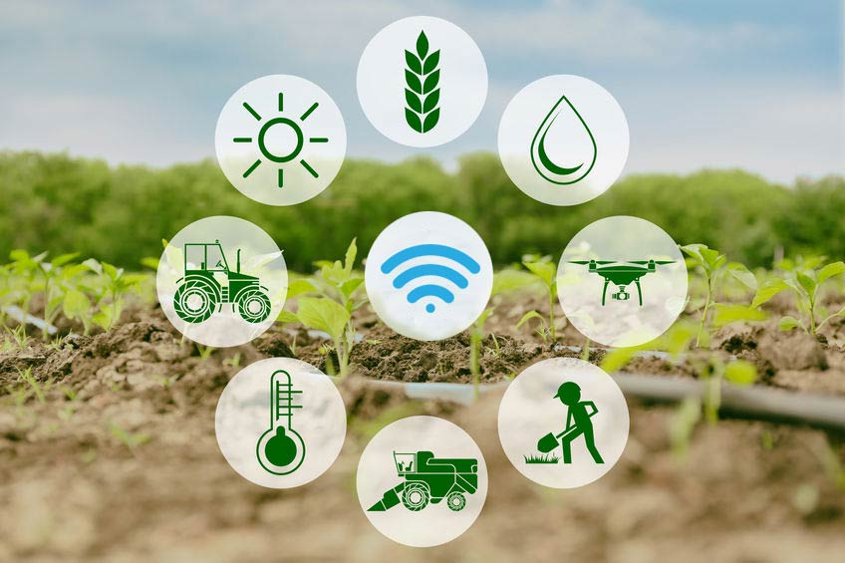
AGRICULTURE
Precision Farming:
IoT sensors monitor soil moisture, temperature, and crop health, enabling farmers to optimize irrigation and fertilizer usage.
Livestock Monitoring:
IoT-enabled ear tags tracks the health and location of livestock, helping farmers detect diseases early and, manage herd efficiently

Slide 91
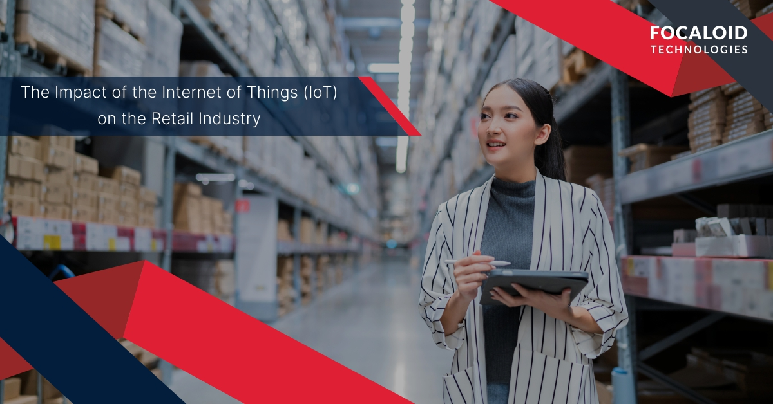
RETAIL
Inventory Management:
RFID tags and IoT sensors track inventory levels in real-time, reducing stockouts and improving inventory turnover.
Personalized Shopping Experience:
IoT beacons in stores send personalized offers and recommendations to shoppers’ smartphones based on their location and purchase history

